Slide 1

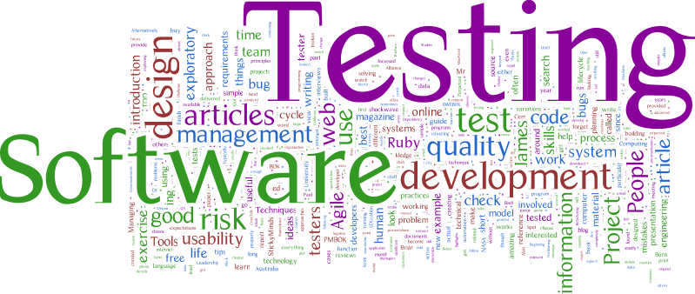
What is Software Testing
Software testing is widely used technology because it is compulsory to test each and every software before deployment
Software testing is a process of identifying the correctness of software by considering its all attributes (Reliability, Scalability, Portability, Re-usability, Usability) and evaluating the execution of software components to find the software bugs or errors or defects
Laxman Gudivada

Slide 2



Definition of Testing
Software testing can be stated as the process of verifying and validating whether a software or application is bug-free, meets the technical requirements as guided by its design and development, and meets the user requirements effectively and efficiently by handling all the exceptional and boundary cases.
The process of software testing aims not only at finding faults in the existing software but also at finding measures to improve the software in terms of efficiency, accuracy, and usability. It mainly aims at measuring the specification, functionality, and performance of a software program or application.
Software testing can be divided into two steps: 1. Verification: it refers to the set of tasks that ensure that the software correctly implements a specific function.
2. Validation: it refers to a different set of tasks that ensure that the software that has been built is traceable to customer requirements.

Slide 3




Need of Software Testing
Helps in saving money
Security
Quality of the product
Satisfaction of the customer
Enhancing the development process
Easy while adding new features
Determining the performance of the software

Slide 4
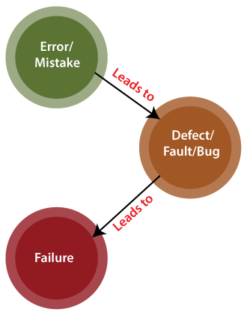
Error, Fault & Failure in Testing
ERROR:
An error is a mistake, misconception, or misunderstanding on the part of a software developer. In the category of the developer, we include software engineers, programmers, analysts, and testers. For example, a developer may misunderstand a de-sign notation, or a programmer might type a variable name incorrectly – leads to an Error. It is the one that is generated because of the wrong login, loop or syntax. The error normally arises in software; it leads to a change in the functionality of the program.
FAILURE:
A failure is the inability of a software system or component to perform its required functions within specified performance requirements. When a defect reaches the end customer it is called a Failure. During development, Failures are usually observed by testers
FAULT:
An incorrect step, process or data definition in a computer program that causes the program to perform in an unintended or unanticipated manner.

Slide 5
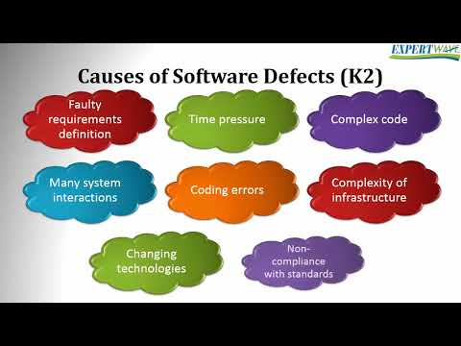
Reasons for Software Bugs
Lack of designing experience
Lack of coding practices experience
Human factors introduces errors in code
Lack of version control
Buggy third-party tools
Last minute changes in the requirement introduce error
Poor Software testing skill
Miscommunication of requirements introduces error in code
Unrealistic time schedule for development

Slide 6

How does software testing Reveal..?
Software testing is the process of evaluating and verifying that a software product or application does what is it supposed to do. The benefits of testing include preventing bugs, reducing development costs and improving performance.
analyzing the product requirements for completeness and correctness in various contexts like industry perspective, business perspective, feasibility and viability of implementation, usability, performance, security, infrastructure considerations, etc.
reviewing the product architecture and the overall design of the product
working with product developers on improvement in coding techniques, design patterns, tests that can be written as part of code based on various techniques like boundary conditions, etc.

Slide 7
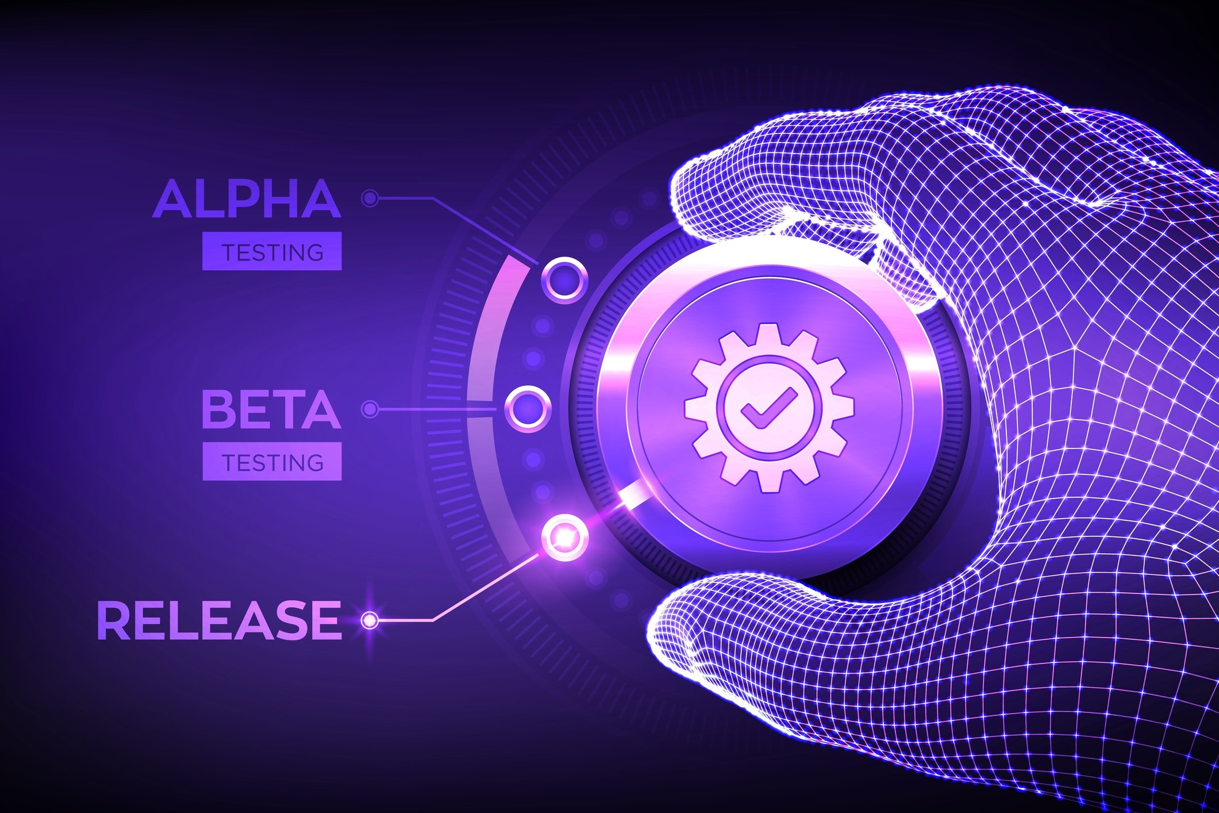
Importance of software testing
Updating and replacing software is essential to business these days. In a world where technology is more accessible than ever, it is a part of our life, with regular updates on mobile devices, system down time for website maintenance and more - the list goes on
Name
Title
Title
Title
1. Increase the quality
4. Cost Effective
2. We all make mistakes
5. Gain customer confidence
3. Reduce risks

Slide 8
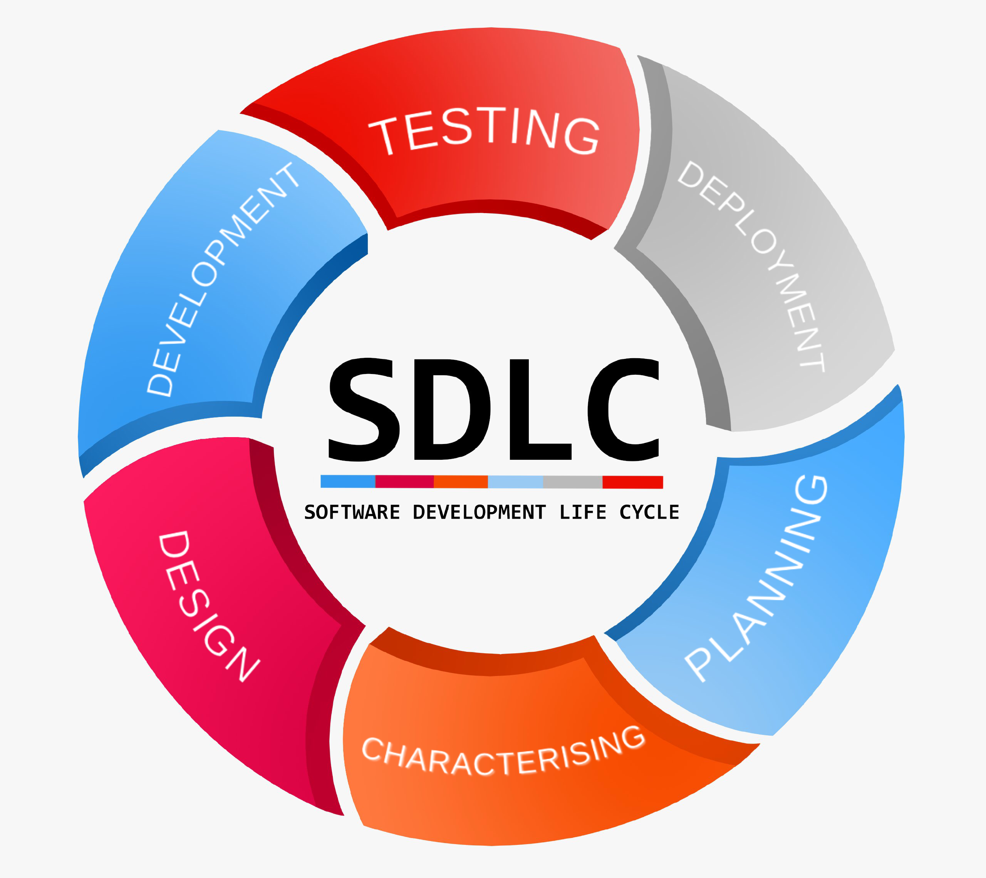
Importance of Testing And Quality In SDLC Phases
Software Development Life Cycle (SDLC) is a process used by the software industry to design, develop and test high quality softwares. The SDLC aims to produce a high-quality software that meets or exceeds customer expectations, reaches completion within times and cost estimates.
SDLC is the acronym of Software Development Life Cycle.
It is also called as Software Development Process.
SDLC is a framework defining tasks performed at each step in the software development process.
ISO/IEC 12207 is an international standard for software life-cycle processes. It aims to be the standard that defines all the tasks required for developing and maintaining software.

Slide 9
SDLC Methods
1: Planning and Requirement Analysis
Requirement analysis is the most important and fundamental stage in SDLC. It is performed by the senior members of the team with inputs from the customer, the sales department, market surveys and domain experts in the industry.
4: Building or Developing the Product
In this stage of SDLC the actual development starts and the product is built. The programming code is generated as per DDS during this stage.
5: Testing the Product
This stage is usually a subset of all the stages as in the modern SDLC models, the testing activities are mostly involved in all the stages of SDLC. However, this stage refers to the testing only stage of the product where product defects are reported, tracked, fixed and retested, until the product reaches the quality standards defined in the SRS.
2: Defining Requirements
Once the requirement analysis is done the next step is to clearly define and document the product requirements and get them approved from the customer or the market analysts. This is done through an SRS (Software Requirement Specification) document which consists of all the product requirements to be designed and developed during the project life cycle.
6: Deployment in the Market and Maintenance
Once the product is tested and ready to be deployed it is released formally in the appropriate market. Sometimes product deployment happens in stages as per the business strategy of that organization.
3: Designing the Product Architecture
SRS is the reference for product architects to come out with the best architecture for the product to be developed. Based on the requirements specified in SRS, usually more than one design approach for the product architecture is proposed

Slide 10
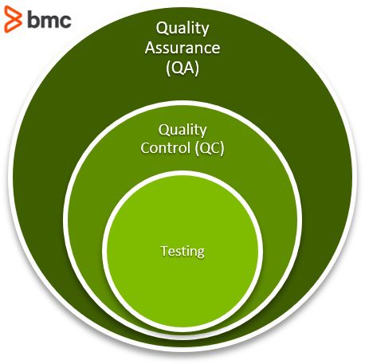
Quality by Software Testing Perspective
1) A Good Quality Software Product.
2) Customer needs are not always translated into his requirements.
3) A Software Free from Bugs or Defects may not always be a Product of Good Quality.
4) A Software may be termed as a Product of Good Quality of presence in some Bugs or Defects in it.
5) Maintaining quality of a software product is not only the responsibility of software testers.
6) Software tester should endeavor to detect bugs in the software right from the beginning itself.
7) Quality Factors for any Software are essential attributes, absence of which can pose threat to its success.
8) Cost of software quality refers to the total expenditure incurred on firstly preventing the errors, secondly identifying the errors and lastly correcting these errors.
9) Cost of detecting and fixing a bug is possible to be brought down, if the bug is unable to be detected during the early stages of development.
.

Slide 11

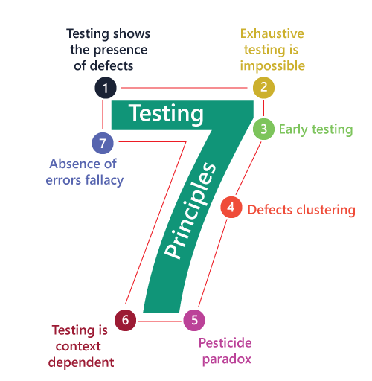
Software Testing Principles
Testing shows the presence of defects
Exhaustive Testing is not possible
Early Testing
Defect Clustering
Pesticide Paradox
Testing is context-dependent
Absence of errors fallacy

Slide 12
1. Testing shows the presence of defects
The test engineer will test the application to make sure that the application is bug or defects free. While doing testing, we can only identify that the application or software has any errors.
5. Pesticide paradox
This principle defined that if we are executing the same set of test cases again and again over a particular time, then these kinds of the test will not be able to find the new bugs in the software or the application..
2.Exhaustive Testing is not possible
Sometimes it seems to be very hard to test all the modules and their features with effective and non- effective combinations of the inputs data throughout the actual testing process.
6. Testing is context-dependent
Testing is a context-dependent principle states that we have multiple fields such as e-commerce websites, commercial websites, and so on are available in the market. There is a definite way to test the commercial site as well as the e-commerce websites because every application has its own needs, features, and functionality..
3.Early Testing
Here early testing means that all the testing activities should start in the early stages of the software development life cycle's requirement analysis stage to identify the defects because if we find the bugs at an early stage
6. Absence of errors fallacy
Once the application is completely tested and there are no bugs identified before the release, so we can say that the application is 99 percent bug-free. But there is the chance when the application is tested beside the incorrect requirements, identified the flaws.
4.Defect clustering
The defect clustering defined that throughout the testing process, we can detect the numbers of bugs which are correlated to a small number of modules.

Slide 13
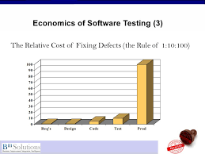
Economics of Software Testing
The challenge facing any software development manager is how to balance the natural tension that exists between time, cost and quality. On top of this, Programes also have to balance the three Organisational elements of corporate strategy, delivery mechanisms for change and the business-as-usual environment. Quite a balancing act.
void quality shortcuts
- reduce rework and business impact costs
- Be realistic with scope within the constraints of cost and time tolerances
- Prioritise desired features and anticipated benefits
- Exercise rigour with requirements quality and clarity before committing to development
- Use risk-based prioritisation to focus efforts - work smart
- Ensure regular stakeholder engagement and feedback
- Enforce acceptance criteria and phase containment between test phases
- Adopt best practise testing methodology such as the SQS Vicars model
Relative cost of defects
Defect insertion and detection points
The cost of testing process omissions

Slide 14
Relative cost of defects:
The following chart is a summary of the relative cost of fixing defects detected at various stages in the software development lifecycle process in a typical project. The cost of defect removal increases exponentially as the development lifecycle progresses. In addition, the later defects are found and fixed, the greater the risk to the business they pose.
Defect insertion and detection points:
Defects are introduced to a system at a number of points during the software development lifecycle. The following chart is a model of a typical development lifecycle that illustrates the usual points of defect insertion and detection.

Slide 15

Thank You

